Slide 1
Porter Stemmer Algorithm

Slide 2
Stemming
Stemming is suffix stripping operation
Process of reducing word into its base form (Root form/stem form)
This is achieved by cutting of begging or end of the word
Eg:
Playing- Play
Boys- Boy
Popular Algorithm is Porter Stemmer

Slide 3
Porter Stemmer
– Five sets of rules, applied in order
– Within each set, if more than one of the rules can apply, only the one with the longest matching suffix (S1) is followed
Advantage: easy to see understand, easy to implement.

Slide 4
Algorithm
Few definitions.
Consonant-
it is a letter other than A, E, I, O or U, and other than Y preceded by a consonant.
So, in TOY the consonants are T and Y, and in SYZYGY they are S, Z and G.
If a letter is not a consonant it is a vowel.

Slide 5
Algorithm
A consonant will be denoted by c, a vowel by v.
A list ccc... of length greater than 0 will be denoted by C,
and a list vvv... of length greater than 0 will be denoted by V.
Any word, or part of a word, therefore, has one of the four forms:
CVCV ... C
CVCV ... V
VCVC ... C
VCVC ... V

Slide 6
Algorithm
These may all be represented by the single form [C]VCVC ... [V] where the square brackets denote arbitrary presence of their contents.
Using ($VC^m$) to denote VC repeated m times, this may again be written as [C]($ VC^m $)[V] m will be called the measure of any word or word part when represented in this form.
The case m = 0 covers the null word. Here are some examples: (m is no of VC pairs)
m=0 TR, EE, TREE, Y, BY.
m=1 TROUBLE, OATS, TREES, IVY.
m=2 TROUBLES, PRIVATE, OATEN, ORRERY.

Slide 7
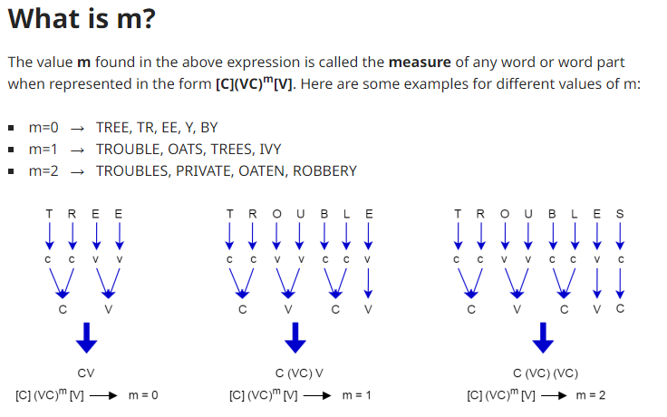

Slide 8
The rules for removing a suffix will be given in the form (condition) S1 -> S2 This means that if a word ends with the suffix S1, and the stem before S1 satisfies the given condition, S1 is replaced by S2. The condition is usually given in terms of m,
e.g.(m > 1) EMENT -> Here S1 is 'EMENT' and S2 is null.
This would map REPLACEMENT to REPLAC, since REPLAC is a word part for which m = 2.

Slide 9
The 'condition' part may also contain the following:
*S - the stem ends with S (and similarly for the other letters).
*v* - the stem contains a vowel.
m=2 TROUBLES, PRIVATE, OATEN, ORRERY.
*d - the stem ends with a double consonant (e.g. -TT, -SS).
*o - the stem ends cvc, where the second c is not W, X or Y (e.g. -WIL, -HOP).

Slide 10
And the condition part may also contain expressions with and, or and not, so that:
(m>1 and (*S or *T)) : tests for a stem with m>1 ending in S or T, while
(*d and not (*L or *S or *Z)) : tests for a stem ending with a double consonant other than L, S or Z.
Elaborate conditions like this are required only rarely.

Slide 11
In a set of rules written beneath each other, only one is obeyed, and this will be the one with the longest matching S1 for the given word.
For example, with
SSES -> SS
IES -> I
SS -> SS
S ->
(here the conditions are all null) CARESSES maps to CARESS since SSES is the longest match for S1. Equally CARESS maps to CARESS (S1=SS) and CARES to CARE (S1=S).
In the rules below, examples of their application, successful or otherwise, are given on the right in lower case. The algorithm now follows:

Slide 12
Step 1a :
SSES -> SS (Example : caresses -> caress)
IES -> I (Example : ponies -> poni ; ties -> ti)
SS -> SS (Example : caress -> caress)
S -> (Example : cats -> cat)

Slide 13
Step 1b :
(m>0) EED -> EE (Example : feed -> feed ; agreed -> agree)
(v) ED -> (Example : plastered -> plaster ; bled -> bled)
(v) ING -> (Example : motoring -> motor ; sing -> sing)
S -> (Example : cats -> cat)

Slide 14
If the second or third of the rules in Step 1b is successful, the following is done:
AT -> ATE (Example : conflat(ed) -> conflate)
BL -> BLE (Example : troubl(ed) -> trouble)
IZ -> IZE (Example : siz(ed) -> size)
S -> (Example : cats -> cat)
(*d and not (*L a q a or *S or *Z)) -> single letter
(Example : hopp(ing) -> hop ; tann(ed) -> tan ; fall(ing) -> fall ; hiss(ing) -> hiss ; fizz(ed) -> fizz)
(m=1 and *o) -> E (Example : fail(ing) -> fail ; fil(ing) -> file)

Slide 15
The rule to map to a single letter causes the removal of one of the double letter pair.
The -E is put back on -AT, -BL and -IZ, so that the suffixes -ATE, -BLE and -IZE can be recognized later.
This E may be removed in step 4.

Slide 16
Step 1c :
(\*v\*) Y -> I (Example : happy -> happi ; sky -> sky)
Step 1 deals with plurals and past participles. The subsequent steps are much more straightforward.

Slide 17
Step 2 :
(m>0) ATIONAL -> ATE (Example : relational -> relate
(m>0) TIONAL -> TION (Example : conditional -> condition ; rational -> rational)
(m>0) ENCI -> ENCE (Example : valenci -> valence)
(m>0) ANCI -> ANCE (Example : hesitanci -> hesitance)
(m>0) IZER -> IZE (Example : digitizer -> digitize)
(m>0) ABLI -> ABLE (Example : conformabli -> conformable)
(m>0) ALLI -> AL (Example : radicalli -> radical)
(m>0) ENTLI -> ENT (differentli -> different)
(m>0) ELI -> E (vileli -> vile)
(m>0) OUSLI -> OUS (analogousli -> analogous)
(m>0) IZATION -> IZE (vietnamization -> vietnamize)

Slide 18
Step 2:Continue
(m>0) ATION -> ATE (predication -> predicate)
(m>0) ATOR -> ATE (operator -> operate)
(m>0) ALISM -> AL (feudalism -> feudal)
(m>0) IVENESS -> IVE (decisiveness -> decisive)
(m>0) FULNESS -> FUL (hopefulness -> hopeful)
(m>0) OUSNESS -> OUS (callousness -> callous)
(m>0) ALITI -> AL (formaliti -> formal)
(m>0) IVITI -> IVE (sensitiviti -> sensitive)
(m>0) BILITI -> BLE (sensibiliti -> sensible)

Slide 19
Step 2:Continue
The test for the string S1 can be made fast by doing a program switch on the penultimate letter of the word being tested. This gives a fairly even breakdown of the possible values of the string S1. It will be seen in fact that the S1-strings in step 2 are presented here in the alphabetical order of their penultimate letter. Similar techniques may be applied in the other steps.

Slide 20
Step 3 :
(m>0) ICATE -> IC (Example : triplicate -> triplic)
(m>0) ATIVE -> (Example : formative -> form)
(m>0) ALIZE -> AL (Example : formalize -> formal)
(m>0) ICITI -> IC (Example : electriciti -> electric))
(m>0) ICAL -> IC (Example : electrical -> electric)
(m>0) FUL -> (Example : hopeful -> hope)
(m>0) NESS -> (Example : goodness -> good)

Slide 21
Step 4 :
(m>1) AL -> (Example : revival -> reviv)
(m>1) ANCE -> (Example : allowance -> allow)
(m>1) ENCE -> (Example : inference -> infer)
(m>1) ER -> (Example : airliner -> airlin)
(m>1) IC -> (Example : gyroscopic -> gyroscop)
(m>1) ABLE -> (Example : adjustable -> adjust)
(m>1) IBLE -> (Example : defensible -> defens)
(m>1) ANT -> (Example : irritant -> irrit)
(m>1) EMENT -> (Example : replacement -> replac)
(m>1) MENT -> (Example : adjustment -> adjust)
(m>1) ENT -> (Example : dependent -> depend)

Slide 22
Step 4 :Continued
(m>1 and (*S or *T)) ION -> (Example : adoption -> adopt)​
(m>1) OU -> (Example : homologou -> homolog)​
(m>1) ISM -> (Example : communism -> commun)​
(m>1) ATE -> (Example : activate -> activ)​
(m>1) ITI -> (Example : angulariti -> angular)​
(m>1) OUS -> (Example : homologous -> homolog)​
(m>1) IVE -> (Example : effective -> effect)​
(m>1) IZE -> (Example : bowdlerize -> bowdler)​
The suffixes are now removed. All that remains is a little tidying up.​​

Slide 23
Step 5a :
(m>1) E -> (Example : probate -> probat ; rate -> rate)
(m=1 and not *o) E -> (Example : cease -> ceas)

Slide 24
Step 5b
(m > 1 and *d and *L) -> single letter
(Example : controll -> control ; roll -> roll)

